Slide 1

Multi Agent System for Fraud Analysis
By: Arushi Pradhan
Notes:
Arushi
Hi, we’re Tania and Arushi, and this project is about combining machine learning with graph search to analyze fraud in transaction networks.
Instead of just predicting fraud, we use those predictions to guide how we explore connections between customers and merchants. Our goal is to move beyond isolated predictions and uncover patterns of suspicious activity across the network.

Slide 2
Problem & Motivation
Fraud detection is a complex network problem
Traditional approaches fall into two isolated categories:
ML only — classifies each transaction independently, ignoring network structure and relationships between entities
Graph only — analyzes connections between customers and merchants, but lacks predictive risk scoring
Gap: No existing framework integrates both ML predictions and graph search into a unified system
Idea: Use ML-generated fraud risk scores to guide graph traversal algorithms and multi agent support, enabling intelligent, risk-informed exploration of transaction networks
ML Only
Classification of individual transactions without network context
+
Graph Only
Structural analysis of connections without predictive risk scoring
Notes:
Fraud detection isn’t just about individual transactions, it’s really a network problem involving relationships between customers and merchants.
Traditional approaches fall into two categories. Machine learning models classify transactions independently but ignore network structure. Graph-based methods analyze connections, but they don’t incorporate predictive risk.
This creates a gap, where predictions and structure are not integrated.
Our idea is to combine both by using machine learning-generated risk scores to guide graph search, enabling more informed exploration of the network.

Slide 3
Dataset
Attribute | Description
customer | Customer identifier
merchant | Merchant identifier
amount | Transaction amount
category | Transaction category
fraud | Binary fraud label
Dataset Statistics
20k
~600k
Transactions
Original Size
5
2
Core Fields
Node Types
BankSim Dataset
Widely used synthetic dataset for fraud detection research
Synthetic financial transactions with fraud labels
Sampling: Reduced from about 600k → 20k for real-time performance
Retains structural complexity and fraud patterns
Why sample?
Full dataset computation is too slow for interactive exploration. The 20k subset enables:
Real-time Streamlit interactivity
Fast search algorithm comparison
Responsive sensitivity experiments

Slide 4
Search Algorithms
Two search strategies are compared: structural baseline vs. risk-informed traversal
BFS
A*
Breadth-First Search
A* Search
Approach: Explores graph level by level, expanding all neighbors at the current depth before moving deeper
Objective: Find the shortest path in terms of number of edges
Risk awareness: None — treats all edges equally
Role: Baseline method for structural comparison
Approach: Cost-guided search combining accumulated cost with heuristic estimate
Objective: Minimize total cost along the path
Risk awareness: Uses ML-derived cost = 1 − risk
Role: Risk-informed path discovery
ML-guided, prioritizes suspicious paths
8 / 18
Notes:
Arushi
We compare two search strategies: a structural baseline and a risk-informed approach.
Breadth-first search explores the graph level by level and finds the shortest path in terms of number of edges, but it does not consider fraud risk.
In contrast, A-star search is cost-guided. It minimizes total path cost using the risk-based cost we defined earlier.
This means A-star prioritizes paths that include high-risk transactions, allowing it to surface more suspicious activity.
This comparison helps us evaluate the impact of integrating machine learning into the search process.

Slide 5
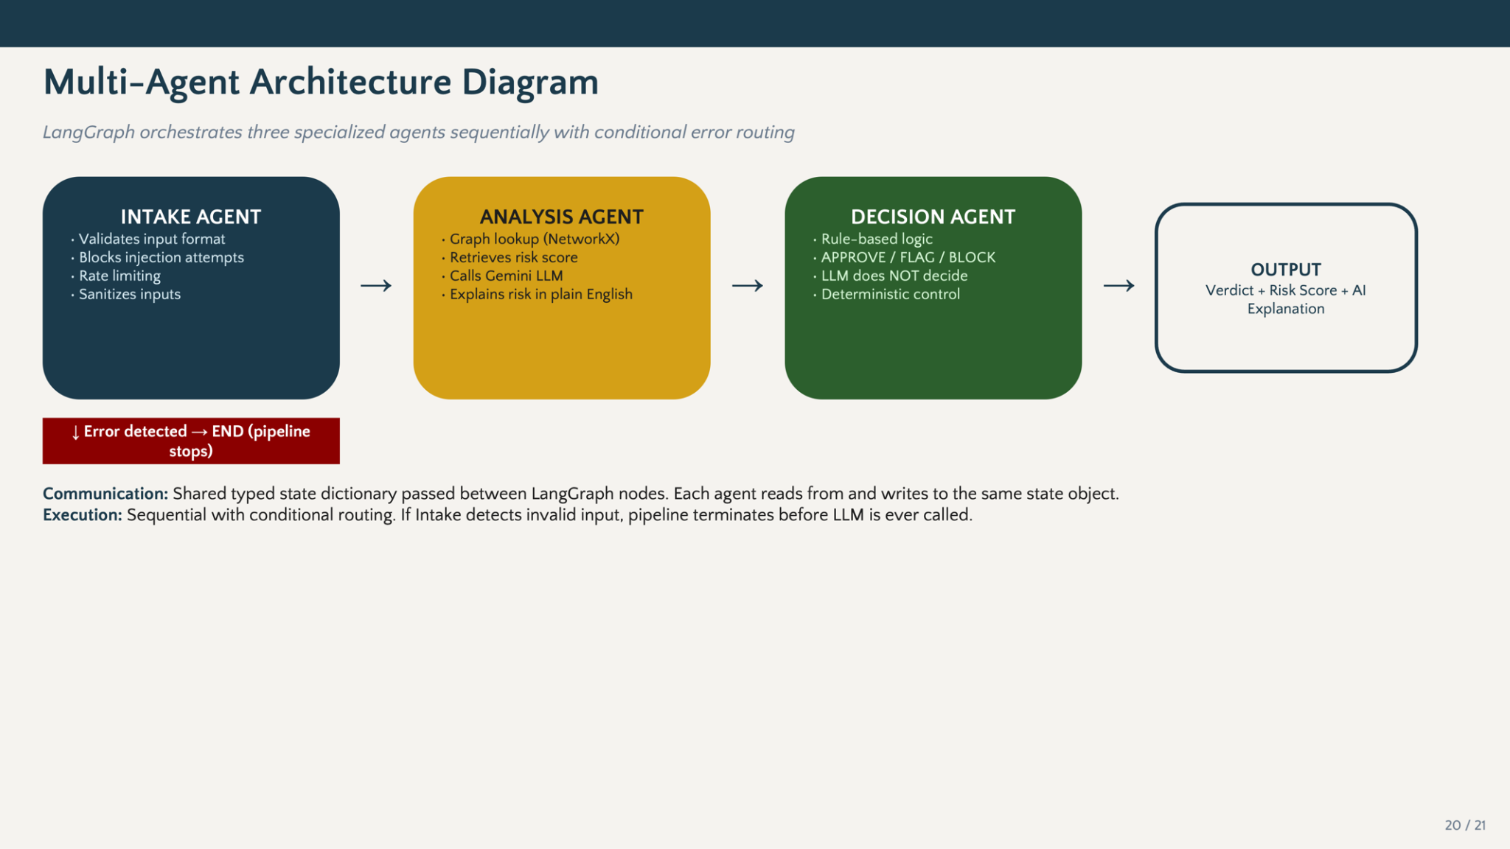

Slide 6
